Slide 1

The Four Seasons
Review and Quiz
Fun video! Click me!
Click the symbol to move on
Notes:
At end of review and quiz students should know and be able to identify basic differences between the four seasons.

Slide 2
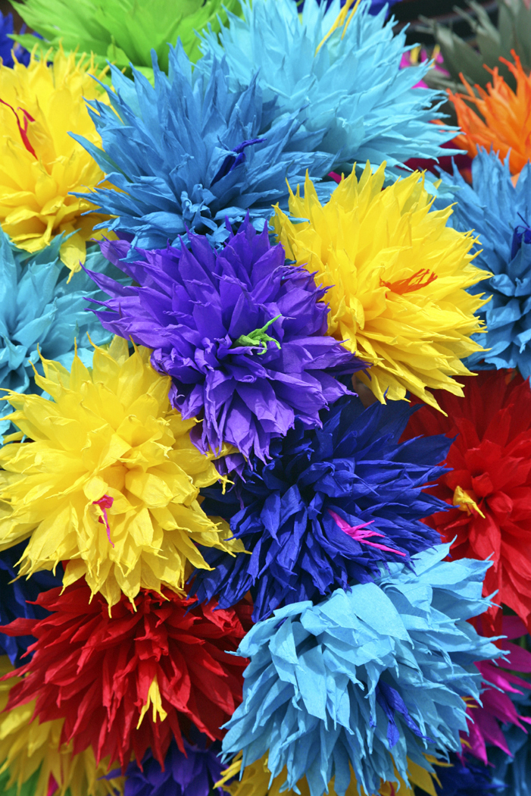
SPRING
Flowers start growing
Bright colors and green everywhere
Rainy season
TAKE QUIZ
SUMMER

Slide 3
SUMMER
Hot, hot, hot!!!
Short sleeves and tank top weather
Swimming fun/ school is out!
TAKE QUIZ
FALL/AUTUMN
SPRING

Slide 4
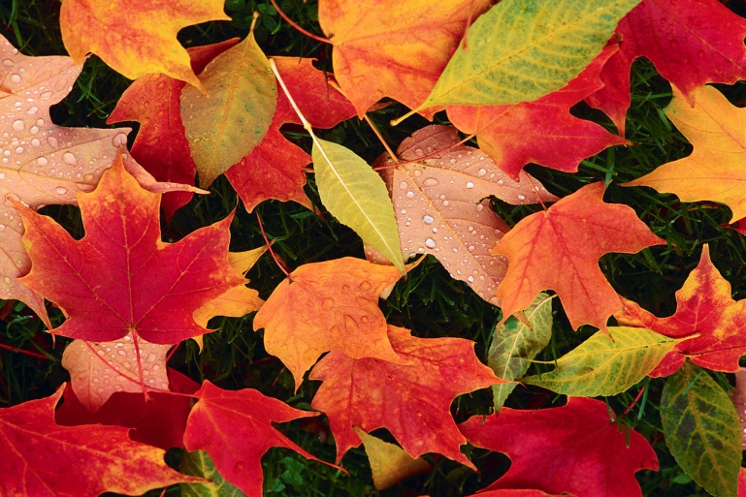
FALL/AUTUMN
Leaves change colors and fall off sleeves
Weather turns cooler
Longer sleeves/ school begins
TAKE QUIZ
WINTER

Slide 5
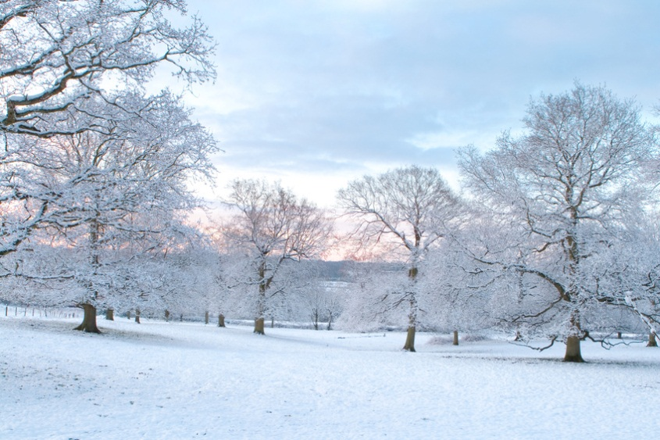
WINTER
Coats, hats, scarfs, mittens
Snow and COLD weather
Holidays! New Year!
TAKE QUIZ
SPRING
Click on the picture for more info, click “TAKE QUIZ” or SPRING to move on or go back for more review
Notes:
Winter clothes song and other songs and stories for children located at www.littlestorybug.com

Slide 6
SEASONS QUIZ
Read each question and click on the correct answer below
START QUIZ
Notes:
Students will be shown if their answer is correct or incorrect immediately after choosing. More than one incorrect answer shows need for more practice with the topic

Slide 7
QUIZ question 1
What season has the coldest weather?
WINTER
SPRING
SUMMER

Slide 8
QUIZ question 2
During which season do the leaves fall off the trees?
SPRING
FALL
WINTER

Slide 9
QUIZ question 3
What season is best for going swimming?
WINTER
SUMMER
SPRING

Slide 10
QUIZ question 4
What is the correct order for the seasons?
SUMMER
SPRING
FALL
WINTER
FALL
SPRING
WINTER
SUMMER
WINTER
SPRING
SUMMER
FALL

Slide 11

YOU GOT IT RIGHT!!!
Move on to question 2

Slide 12
SORRY, TRY AGAIN
BACK TO QUESTION

Slide 13
YOU GOT IT RIGHT!!!
Move on to question 3

Slide 14
SORRY, TRY AGAIN
BACK TO QUESTION 2

Slide 15
YOU GOT IT RIGHT!!!
Move on to question 4

Slide 16
SORRY, TRY AGAIN
BACK TO QUESTION 3

Slide 17
YOU GOT IT RIGHT!
GREAT GOING! YOU MADE IT TO THE END!

Slide 18
SORRY, TRY AGAIN
BACK TO QUESTION 4

